Slide 1
Deep RL with Double Q-Learning
Jacob Heglund, Jake Headings, Nitin Tangellamudi,
Sahil Kumar, Jason Wu
IE 534 – Group Project
December 11, 2018

Slide 2
Original Paper’s Results
3 main results we wanted to replicate
Training in Complex Environments
Show that RL agents can be trained using a “deep” variant of Q-Learning
Better Training
Show that Double Deep Q-Learning improves training results compared to Single Deep Q-Learning
3. Reduce Overestimation
Show that DDQN reduces the q-value estimates compared to DQN

Slide 3
Our Work
Implemented both DQN and DDQN using Pytorch
Trained on a subset of the Atari Learning Environment
High Performing Games
Robotank
Demon Attack
Medium Performing Games
Pong
Zaxxon
Low Performing Games
Ms. Pacman
Montezuma’s Revenge

Slide 4
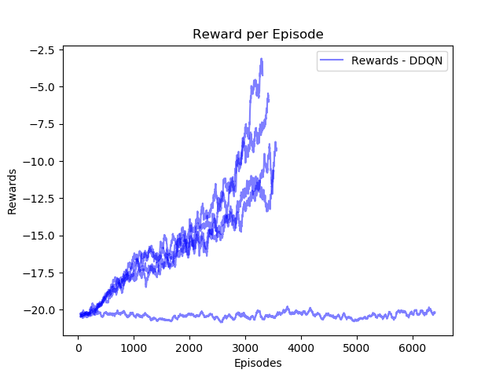
Our Work
Dealing with “bad” random seeds
Same code, different results!

Slide 5
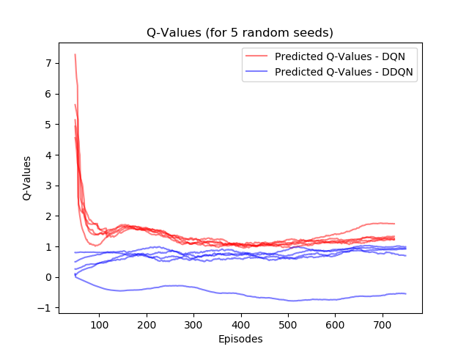
Reducing Overestimation
For Pong, we see that DQN consistently overestimates the Q-Value of a state action pair

Slide 6
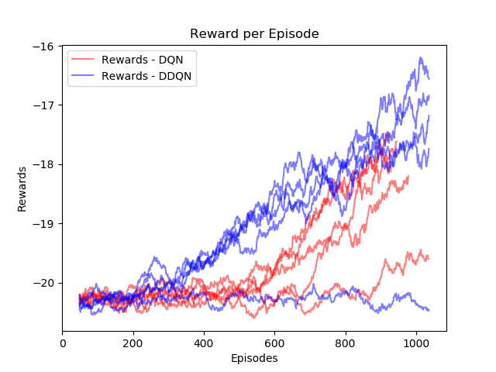
Improving Performance
We also see that DDQN improves faster than DQN, improving sample efficiency

Slide 7

Training in Complex Environments
Check out the full video here ->

Slide 8
Questions?

